Slide 1
CSE 210
Week 03 Abstraction part 1
W. Clements

Slide 2
Agenda
W03 Prepare: Learning Activity
Unit 02 Develop: Journal Program
W03 Team Activity: Designer
W03 Team Activity: Participation Report
W04 Team Activity—Code Review Participation Report
W04 Prove: Developer
W04 Prove: Articulate
Schedule
Today: Overview of Module
This week:
Design: meet with your team
Start implementation
Next Tuesday:
Q&A: Continue implementation
Next Thursday:
Review
Next Saturday:
Prove: Developer
Prove: Articulate

Slide 3
W03 Prepare: Learning Activity Abstraction Learning Activity
https://byui-cse.github.io/cse210-course-2023/unit02/prepare.html
What is Abstraction?
Abstraction is the process of turning complex ideas into simple ones.
print("hello world") = 3000 lines of C
Simple Complex
This layering of abstractions is exactly how all of the software used in the world today, from text editors like Notepad to social media platforms like Facebook, is written

Slide 4
Introduce yourself to your neighbor

Slide 5
Introduce yourself to your neighbor
How did you introduce yourself?
What words did you use?
How did you identify yourself?
What is a person?
How can we abstractly identify a person in this scenario?

Slide 6
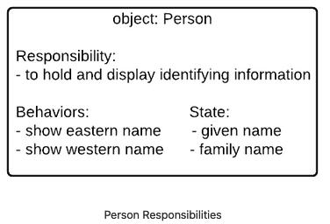
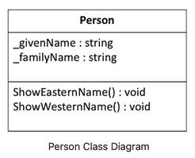
W03 Prepare: Learning Activity Abstraction Learning Activity
https://byui-cse.github.io/cse210-course-2023/unit02/prepare.html
Objects and Classes
Programming with classes is another way of creating abstractions in software.
An object is a conceptual model
for a category of things, real or imagined, that has a specific responsibility within our program.
Objects have states and behavior that allow them to fulfill their responsibility.

Slide 7
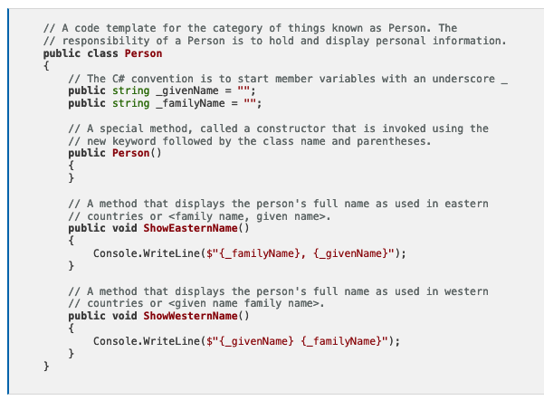
W03 Prepare: Learning Activity Abstraction Learning Activity
https://byui-cse.github.io/cse210-course-2023/unit02/prepare.html

Slide 8

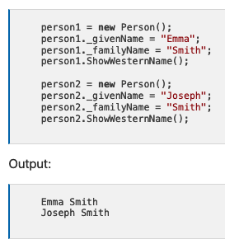
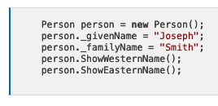
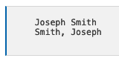
W03 Prepare: Learning Activity Abstraction Learning Activity
https://byui-cse.github.io/cse210-course-2023/unit02/prepare.html
Classes and Instances
A class is just a template for an object.
An instance, or object is the creation of the class in memory.
Recipe vs the item on the plate
Recipe = class,
your dinner is the object instance

Slide 9
W03 Prepare: Learning Activity Abstraction Learning Activity
https://byui-cse.github.io/cse210-course-2023/unit02/prepare.html
Instances and Objects
Many people use the word "object" to refer to an instance of a class as well.
It happens so often that "object" really seems to have a dual meaning.
Abstract view of a conceptual model
Instance of a class

Slide 10
W03 Prepare: Learning Activity Abstraction Learning Activity
https://byui-cse.github.io/cse210-course-2023/unit02/prepare.html
Object = noun
Behavior = Method(verb)
State = Attribute(adjective)
Class = template
Instance = create/memory
Terms and Definitions
Object – representation of real-world noun
Class - A new custom data type that defines attributes (member variables) and methods. This is like a blueprint to create instances or objects of that class.
Example: A Person has given name and family name.
Instance - A variable whose data type is the class. We often use the term Object interchangeably.
Example: We can have two instances of the Person class: one for John, and one for Mary.
Instantiate - A verb that means "to create an instance of."
Example: We can instantiate the Person class to create a new object.
Method - A member function (behavior). Methods are called using "dot notation" with an instance of the class before the dot.
Example: person1.GetEasternName()

Slide 11
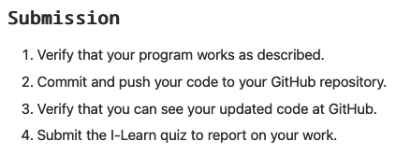
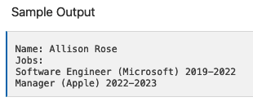
W03 Prepare: Learning Activity Abstraction Learning Activity
https://byui-cse.github.io/cse210-course-2023/unit02/prepare.html
Activity Instructions
Design the Classes
Start the Project
Create the Job class
Test your Job class
Add a Display method to the Job class
Create the Resume class
Test your Resume class
Add a Display method to the Resume class

Slide 12
W03 Prepare: Learning Activity Abstraction Learning Activity
https://byui-cse.github.io/cse210-course-2023/unit02/prepare.html
Activity Instructions
Design the Classes
Start the Project
Create the Job class
Test your Job class
Add a Display method to the Job class
Create the Resume class
Test your Resume class
Add a Display method to the Resume class
Practice the principle of abstraction by creating classes to represent a resume or an job history for a person like you might see on LinkedIn.

Slide 13
W03 Prepare: Learning Activity Abstraction Learning Activity
https://byui-cse.github.io/cse210-course-2023/unit02/prepare.html
Class: Job
Class: Resume
Activity Instructions
Design the Classes
Start the Project
Create the Job class
Test your Job class
Add a Display method to the Job class
Create the Resume class
Test your Resume class
Add a Display method to the Resume class
Practice the principle of abstraction by creating classes to represent a resume or an job history for a person like you might see on LinkedIn.

Slide 14
Practice the principle of abstraction by creating classes to represent a resume or an job history for a person like you might see on LinkedIn.
Input
Process
Output
main

Slide 15
W03 Prepare: Learning Activity Abstraction Learning Activity
https://byui-cse.github.io/cse210-course-2023/unit02/prepare.html
Class: Job
Responsibilities:
Keeps track of the company, job title, start year, and end year.
Behaviors:
Displays the job information in the format "Job Title (Company) StartYear-EndYear", for example: "Software Engineer (Microsoft) 2019-2022".
Class: Resume
Responsibilities:
Keeps track of the person's name and a list of their jobs.
Behaviors:
Displays the resume, which shows the name first, followed by displaying each one of the jobs.
Activity Instructions
Design the Classes
Start the Project
Create the Job class
Test your Job class
Add a Display method to the Job class
Create the Resume class
Test your Resume class
Add a Display method to the Resume class
Practice the principle of abstraction by creating classes to represent a resume or an job history for a person like you might see on LinkedIn.

Slide 16
Class: Job
Responsibilities:
Keeps track of the company, job title, start year, and end year.
Behaviors:
Displays the job information in the format "Job Title (Company) StartYear-EndYear", for example: "Software Engineer (Microsoft) 2019-2022".
Class: Resume
Responsibilities:
Keeps track of the person's name and a list of their jobs.
Behaviors:
Displays the resume, which shows the name first, followed by displaying each one of the jobs.
Practice the principle of abstraction by creating classes to represent a resume or an job history for a person like you might see on LinkedIn.
Input
Process
Output
main

Slide 17
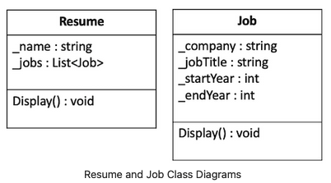
W03 Prepare: Learning Activity Abstraction Learning Activity
https://byui-cse.github.io/cse210-course-2023/unit02/prepare.html
Class: Job
Responsibilities:
Keeps track of the company, job title, start year, and end year.
Behaviors:
Displays the job information in the format "Job Title (Company) StartYear-EndYear", for example: "Software Engineer (Microsoft) 2019-2022".
Class: Resume
Responsibilities:
Keeps track of the person's name and a list of their jobs.
Behaviors:
Displays the resume, which shows the name first, followed by displaying each one of the jobs.
Activity Instructions
Design the Classes
Start the Project
Create the Job class
Test your Job class
Add a Display method to the Job class
Create the Resume class
Test your Resume class
Add a Display method to the Resume class
Practice the principle of abstraction by creating classes to represent a resume or an job history for a person like you might see on LinkedIn.

Slide 18
Class: Job
Responsibilities:
Keeps track of the company, job title, start year, and end year.
Behaviors:
Displays the job information in the format "Job Title (Company) StartYear-EndYear", for example: "Software Engineer (Microsoft) 2019-2022".
Class: Resume
Responsibilities:
Keeps track of the person's name and a list of their jobs.
Behaviors:
Displays the resume, which shows the name first, followed by displaying each one of the jobs.
Practice the principle of abstraction by creating classes to represent a resume or an job history for a person like you might see on LinkedIn.
Input
Process
Output
main

Slide 19
W03 Prepare: Learning Activity Abstraction Learning Activity
https://byui-cse.github.io/cse210-course-2023/unit02/prepare.html
Activity Instructions
Design the Classes
Start the Project
Create the Job class
Test your Job class
Add a Display method to the Job class
Create the Resume class
Test your Resume class
Add a Display method to the Resume class
Open the class project in VS Code.
Navigate to the Learning02 project in the prepare folder. Find the Program.cs file, which will be your entry point for the program.
Verify that you can run the project and see the beginning "Hello World" output.
using System;
class Program
{
static void Main(string[] args)
{
Console.WriteLine("Hello Learning02 World!");
Job job = new Job();
job.display();
bcNewClass nc = new bcNewClass();
}
}

Slide 20
Class: Job
Responsibilities:
Keeps track of the company, job title, start year, and end year.
Behaviors:
Displays the job information in the format "Job Title (Company) StartYear-EndYear", for example: "Software Engineer (Microsoft) 2019-2022".
Class: Resume
Responsibilities:
Keeps track of the person's name and a list of their jobs.
Behaviors:
Displays the resume, which shows the name first, followed by displaying each one of the jobs.
Practice the principle of abstraction by creating classes to represent a resume or an job history for a person like you might see on LinkedIn.
Input
Process
Output
main
using System;
class Program
{
static void Main(string[] args)
{
Console.WriteLine("Hello Learning02 World!");
Job job = new Job();
job.display();
}
}
WriteLine
job
nc

Slide 21
W03 Prepare: Learning Activity Abstraction Learning Activity
https://byui-cse.github.io/cse210-course-2023/unit02/prepare.html
Activity Instructions
Design the Classes
Start the Project
Create the Job class
Test your Job class
Add a Display method to the Job class
Create the Resume class
Test your Resume class
Add a Display method to the Resume class
Create a new file for your job class. By convention this should be named Job.cs .
Create the class (Hint this is the public class Job syntax).
Create member variables in the class for each element that this class should contain. By convention these member variables should begin with an underscore and a lowercase letter such as _jobTitle .
using System;
public class Job
{
public void display()
{
Console.WriteLine("Job Hello Learning02 World!");
}
}

Slide 22
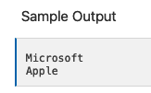
W03 Prepare: Learning Activity Abstraction Learning Activity
https://byui-cse.github.io/cse210-course-2023/unit02/prepare.html
Activity Instructions
Design the Classes
Start the Project
Create the Job class
Test your Job class
Add a Display method to the Job class
Create the Resume class
Test your Resume class
Add a Display method to the Resume class
Back in your Program.cs file, add code to your Main function.
Create a new job instance named job1 .
Set the member variables using the dot notation (for example, job1._jobTitle = "Software Engineer";
Verify that you can display the company of this job on the screen, again using the dot notation to access the member variable.
Create a second job, set its variables, display this company on the screen as well.

Slide 23
Class: Job
Responsibilities:
Keeps track of the company, job title, start year, and end year.
Behaviors:
Displays the job information in the format "Job Title (Company) StartYear-EndYear", for example: "Software Engineer (Microsoft) 2019-2022".
Class: Resume
Responsibilities:
Keeps track of the person's name and a list of their jobs.
Behaviors:
Displays the resume, which shows the name first, followed by displaying each one of the jobs.
Practice the principle of abstraction by creating classes to represent a resume or an job history for a person like you might see on LinkedIn.
Input
Process
Output
main
using System;
class Program
{
static void Main(string[] args)
{
Console.WriteLine("Hello Learning02 World!");
Job job = new Job();
job.display();
}
}
WriteLine
job
job1._jobTitle
job1._jobTitle
job1

Slide 24
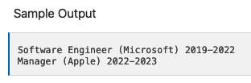
W03 Prepare: Learning Activity Abstraction Learning Activity
https://byui-cse.github.io/cse210-course-2023/unit02/prepare.html
Activity Instructions
Design the Classes
Start the Project
Create the Job class
Test your Job class
Add a Display method to the Job class
Create the Resume class
Test your Resume class
Add a Display method to the Resume class
Return to your Job.cs file and add a method (member function) to display the job details. This method should not have any parameters and does not need to return anything. By convention, this method should begin with a capital letter, such as Display, and if you have multiple words each word should be capitalized, such as DisplayJobDetails .
This method should display the job details on the screen in the correct format. Remember that the method can access the member variables directly, without needing them to be passed into it.
Return to your Program.cs file. Remove the lines of code where you displayed the company earlier, and replace them with calls to your new method. Remember that you call the method using the same dot notation such as job1.Display(); .

Slide 25
Class: Job
Responsibilities:
Keeps track of the company, job title, start year, and end year.
Behaviors:
Displays the job information in the format "Job Title (Company) StartYear-EndYear", for example: "Software Engineer (Microsoft) 2019-2022".
Class: Resume
Responsibilities:
Keeps track of the person's name and a list of their jobs.
Behaviors:
Displays the resume, which shows the name first, followed by displaying each one of the jobs.
Practice the principle of abstraction by creating classes to represent a resume or an job history for a person like you might see on LinkedIn.
Input
Process
Output
main
using System;
class Program
{
static void Main(string[] args)
{
Console.WriteLine("Hello Learning02 World!");
Job job = new Job();
job.display();
}
}
WriteLine
job
job1._jobTitle
job1._jobTitle
job1

Slide 26
W03 Prepare: Learning Activity Abstraction Learning Activity
https://byui-cse.github.io/cse210-course-2023/unit02/prepare.html
Activity Instructions
Design the Classes
Start the Project
Create the Job class
Test your Job class
Add a Display method to the Job class
Create the Resume class
Test your Resume class
Add a Display method to the Resume class
Create a new file for your Resume class. Each class should be in its own file and the file name should match the name of the class.
Create the Resume class.
Create the member variable for the person's name.
Create the member variable for the list of Jobs. (Hint: the data type for this should be List<Job> , and it is probably easiest to initialize this to a new list right when you declare it..)

Slide 27
Class: Job
Responsibilities:
Keeps track of the company, job title, start year, and end year.
Behaviors:
Displays the job information in the format "Job Title (Company) StartYear-EndYear", for example: "Software Engineer (Microsoft) 2019-2022".
Class: Resume
Responsibilities:
Keeps track of the person's name and a list of their jobs.
Behaviors:
Displays the resume, which shows the name first, followed by displaying each one of the jobs.
Practice the principle of abstraction by creating classes to represent a resume or an job history for a person like you might see on LinkedIn.
Input
Process
Output
main
using System;
class Program
{
static void Main(string[] args)
{
Console.WriteLine("Hello Learning02 World!");
Job job = new Job();
job.display();
}
}
WriteLine
job
job1._jobTitle
job1._jobTitle
job1

Slide 28
W03 Prepare: Learning Activity Abstraction Learning Activity
https://byui-cse.github.io/cse210-course-2023/unit02/prepare.html
Activity Instructions
Design the Classes
Start the Project
Create the Job class
Test your Job class
Add a Display method to the Job class
Create the Resume class
Test your Resume class
Add a Display method to the Resume class
Return to your Program.cs. Add the end of the Main function, create a new instance of the Resume class.
Add the two jobs you created earlier, to the list of jobs in the resume object.
Verify that you can access and display the first job title using dot notation similar to myResume._jobs[0]._jobTitle .

Slide 29
Class: Job
Responsibilities:
Keeps track of the company, job title, start year, and end year.
Behaviors:
Displays the job information in the format "Job Title (Company) StartYear-EndYear", for example: "Software Engineer (Microsoft) 2019-2022".
Class: Resume
Responsibilities:
Keeps track of the person's name and a list of their jobs.
Behaviors:
Displays the resume, which shows the name first, followed by displaying each one of the jobs.
Practice the principle of abstraction by creating classes to represent a resume or an job history for a person like you might see on LinkedIn.
Input
Process
Output
main
using System;
class Program
{
static void Main(string[] args)
{
Console.WriteLine("Hello Learning02 World!");
Job job = new Job();
job.display();
}
}
WriteLine
job1._jobTitle
job
job1._jobTitle
job1
resume

Slide 30
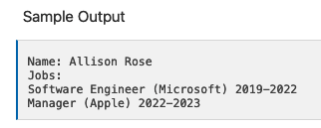
W03 Prepare: Learning Activity Abstraction Learning Activity
https://byui-cse.github.io/cse210-course-2023/unit02/prepare.html
Activity Instructions
Design the Classes
Start the Project
Create the Job class
Test your Job class
Add a Display method to the Job class
Create the Resume class
Test your Resume class
Add a Display method to the Resume class
Return to your Resume class and add a method to display its details.
This method should not have any parameters and should not return anything.
In the method body, you should display the person's name and then iterate through each Job instance in the list of jobs and display them.
Hint: remember that you can call each job's Display method that you created earlier.
Return to your main function, remove any code that is displaying information, and instead, add a call at the end to the Display method from your Resume class to display the name and all the jobs in one line.

Slide 31
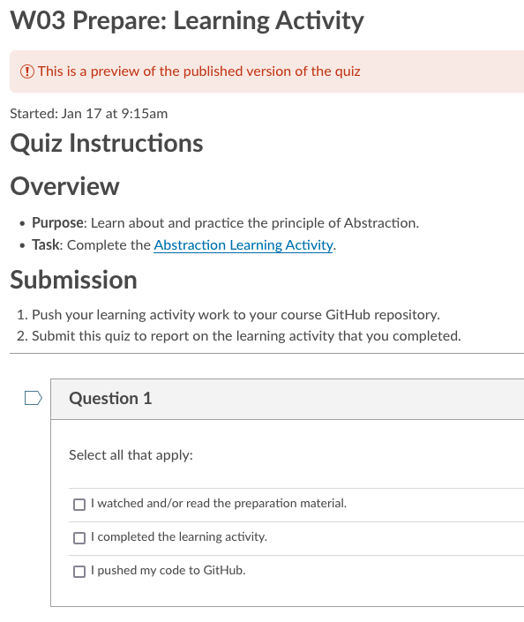
W03 Prepare: Learning Activity Abstraction Learning Activity
https://byui-cse.github.io/cse210-course-2023/unit02/prepare.html
Activity Instructions
Design the Classes
Start the Project
Create the Job class
Test your Job class
Add a Display method to the Job class
Create the Resume class
Test your Resume class
Add a Display method to the Resume class
Submission
Verify that your program works as described.
Commit and push your code to your GitHub repository.
Verify that you can see your updated code at GitHub.
Submit the I-Learn quiz to report on your work.

Slide 33
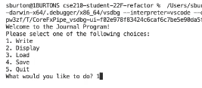
Unit 02 Develop: Journal Program W04 Prove: Developer
https://byui-cse.github.io/cse210-course-2023/unit02/develop.html
Direct link: Journal Program Demo (3 minutes)

Slide 34
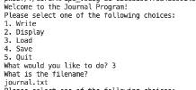
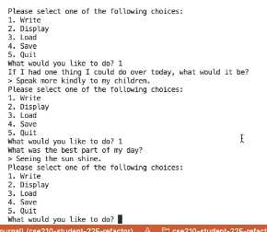
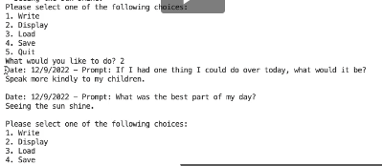
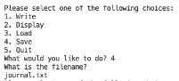
Unit 02 Develop: Journal Program
https://byui-cse.github.io/cse210-course-2023/unit02/develop.html
Direct link: Journal Program Demo (3 minutes)

Slide 35
Unit 02 Develop: Journal Program Problem Overview
https://byui-cse.github.io/cse210-course-2023/unit02/develop.html
A. Many people see the value of keeping a journal to record important events, and many people even set this as a goal. And yet, very few people actually follow through and keep a journal consistently.
Think to yourself for a moment:
What are some reasons people do not follow through with their goal to keep a journal?
Could a program or app help with any of these?
C. While it will not solve all of the people's problems, a great program or an app could help remove some of these barriers.
For example, an app could give you a reminder at a certain time of day or give you a direct link to your document.
B. Some of the reasons you thought of might include the following:
We forget
It's not convenient to get out our written journal or find the electronic document
We don't feel like we have anything interesting to say
We don't feel like we have time for it
We aren't sure what to write
We feel overwhelmed with writing every event of the day, so we don't write anything.
D. Consider the last challenge mentioned above, that of being overwhelmed because it feels like you must write every event during the day; this seems to be a big problem for many people.
Could an app help with this?

Slide 36
Unit 02 Develop: Journal Program Solution Idea
https://byui-cse.github.io/cse210-course-2023/unit02/develop.html
What if the Journal app gave people a simple prompt to respond to every day?
It could also record the response somewhere for them and even add elements like the data automatically.
These features could help address some of the challenges that keep people from journaling and could be included in a mobile app or on a web page.
The actual interface is not that critical, but the ability for a program to help solve a real problem is important to recognize.

Slide 37
Unit 02 Develop: Journal Program Program Specification
https://byui-cse.github.io/cse210-course-2023/unit02/develop.html
For this assignment, you will write a program to help people record the events of their day by supplying prompts and then saving their responses along with the question and the date to a file.
Functional Requirements
Write a new entry (with prompts)
Display the journal
Load the journal from a file
Save the journal to a file
Provide a menu that allows the user to choose these options
Your list of prompts must contain at least five different prompts. :
Who was the most interesting person I interacted with today?
What was the best part of my day?
How did I see the hand of the Lord in my life today?
What was the strongest emotion I felt today?
If I had one thing I could do over today, what would it be?
Your interface should generally follow the pattern shown in the video demo below.

Slide 38
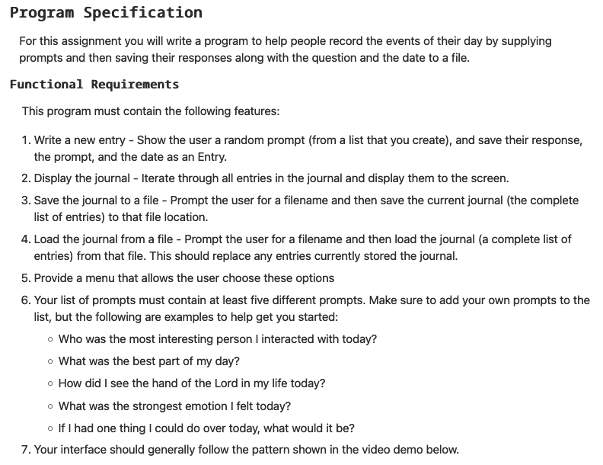
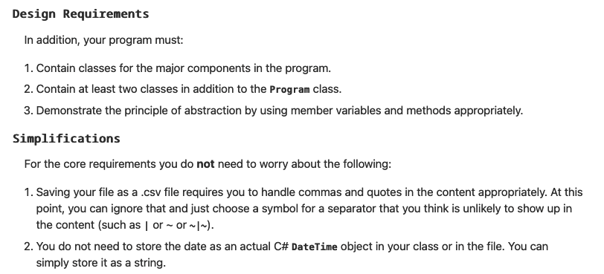
Input
Process
Output
main

Slide 39
Unit 02 Develop: Journal Program Program Specification
https://byui-cse.github.io/cse210-course-2023/unit02/develop.html
For this assignment, you will write a program to help people record the events of their day by supplying prompts and then saving their responses along with the question and the date to a file.
Design Requirements
In addition, your program must:
Contain classes for the major components in the program.
Contain at least two classes in addition to the Program class.
Demonstrate the principle of abstraction by using member variables and methods appropriately.

Slide 40
Input
Process
Output
main

Slide 41
Unit 02 Develop: Journal Program Program Specification
https://byui-cse.github.io/cse210-course-2023/unit02/develop.html
For this assignment, you will write a program to help people record the events of their day by supplying prompts and then saving their responses along with the question and the date to a file.
Simplifications
For the core requirements you do not need to worry about the following:
Saving your file as a .csv file requires you to handle commas and quotes in the content appropriately. At this point, you can ignore that and just choose a symbol for a separator that you think is unlikely to show up in the content (such as | or ~ or ~|~).
You do not need to store the date as an actual C# DateTime object in your class or in the file. You can simply store it as a string.

Slide 42
Unit 02 Develop: Journal Program Program Specification
https://byui-cse.github.io/cse210-course-2023/unit02/develop.html
For this assignment, you will write a program to help people record the events of their day by supplying prompts and then saving their responses along with the question and the date to a file.
Showing Creativity and Exceeding Requirements
Meeting the core requirements makes your program eligible to receive a 93%. To receive 100% on the assignment, you need to show creativity and exceed these requirements.
Here are some ideas you might consider:
Think of other problems that keep people from writing in their journal and address one of those.
Save other information in the journal entry.
Improve the process of saving and loading to save as a .csv file that could be opened in Excel (make sure to account for quotation marks and commas correctly in your content.
Save or load your document to a database or use a different library or format such as JSON for storage.
Report on what you have done to exceed requirements by adding a description of it in a comment in the Program.cs file.

Slide 43
Unit 02 Develop: Journal Program Program Specification
https://byui-cse.github.io/cse210-course-2023/unit02/develop.html
For this assignment, you will write a program to help people record the events of their day by supplying prompts and then saving their responses along with the question and the date to a file.
Design
You will work with your team to create a design for this program. Then, you will each write the code for the program individually.
Develop the Program
In the course repository, find the Develop02 project in the Prove folder and write your program there.

Slide 44
Input
Process
Output
main

Slide 45
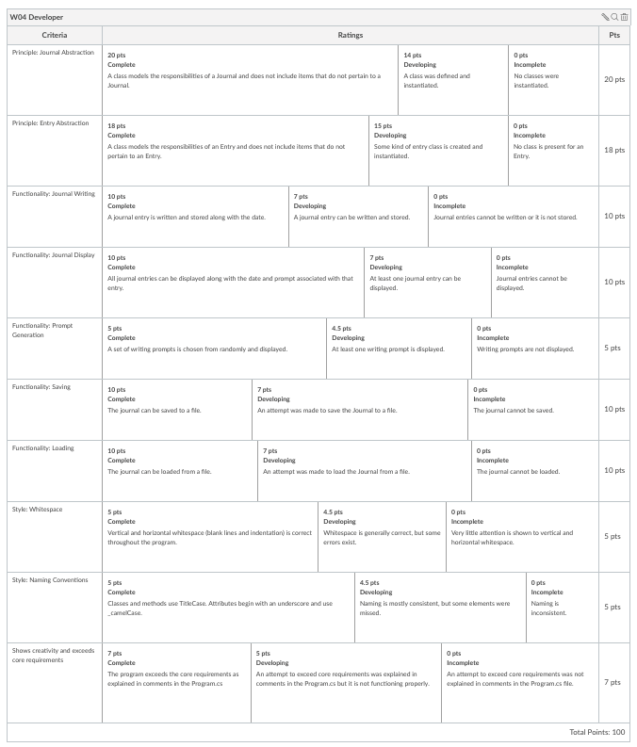
Unit 02 Develop: Journal Program W04 Prove: Developer
https://byui-cse.github.io/cse210-course-2023/unit02/develop.html
For this assignment, you will write a program to help people record the events of their day by supplying prompts and then saving their responses along with the question and the date to a file.
Submission
Develop the program using the principle of Abstraction as described above.
Make sure to describe anything you have done to exceed the requirements in comments in the Program.cs file.
Commit your source code and push it to GitHub.
Verify that you can see your updated code at GitHub.
In I-Learn, submit a link to your GitHub repository. In the submission comment, describe anything you have done to show creativity and exceed the core requirements.

Slide 46
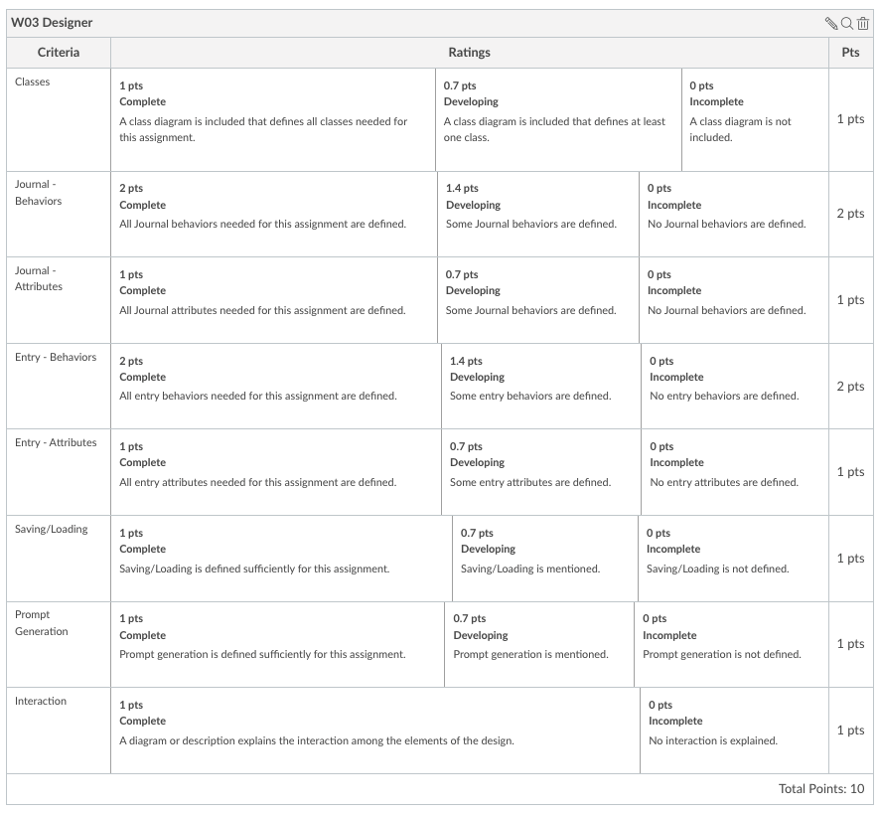
W03 Team Activity: Designer Abstraction - Design Activity
https://byui-cse.github.io/cse210-course-2023/unit02/design.html
Submission - Minimum
Class Diagram
Journal’s Behavior
Journal’s Attributes
Entry’s Behavior
Entry’s Attributes
Saving/Loading defined
Prompt defined
Interaction diagram
Guidance from a Mentor

Slide 47
Input
Process
Output
main
Submission - Minium
Class Diagram
Journal’s Behavior
Journal’s Attributes
Entry’s Behavior
Entry’s Attributes
Saving/Loading defined
Prompt defined
Interaction diagram

Slide 49
W03 Team Activity: Designer Abstraction - Design Activity
Overview
Agenda
Before the meeting: Verify the time, location, and lead student
Begin with Prayer
Discuss the Preparation Learning Activity
Review the Program Specification
Determine the classes
Define class behaviors
Define class attributes
Conclude

Slide 50
Groups
This module’s distribution of work:
Design: team
Implementation: Individual
Review: Team
Coding Standard
Comments: File, Class, Methods
Line Comments:
Variable naming: begin with initials
Class/Attributes/Variables = nouns
Values/States = adjectives
Behavior = Method(verb)

Slide 51
W03 Team Activity: Designer Abstraction - Design Activity
https://byui-cse.github.io/cse210-course-2023/unit02/design.html
Before the meeting: Verify the time, location, and lead student
This could be as simple as posting a message to your MS Teams channel that says something like, "Hi guys, are we still planning to meet tomorrow at 7pm Mountain Time? Let's use the MS Teams video feature again." Or, if someone else has already posted a message like this, it could be as simple as "liking" their message.
Make sure to identify who will be the lead student for this week. For example, "Emily, are you still good to be the lead student for this week?"

Slide 52
W03 Team Activity: Designer Abstraction - Design Activity
https://byui-cse.github.io/cse210-course-2023/unit02/design.html
Begin with Prayer
Discuss the Preparation Learning Activity
Take a minute to talk about the learning activity from this week.
Talk through any difficulties that people had understanding the material or completing the activity.
What part of the learning activity was the hardest for you?

Slide 53
W03 Team Activity: Designer Abstraction - Design Activity
https://byui-cse.github.io/cse210-course-2023/unit02/design.html
Review the Program Specification
Refer to the Journal program specification. As a team, review the program requirements and how it is supposed to work.
What does the program do?
What user inputs does it have?
What output does it produce?
How does the program end?
Guidance from a Mentor
A good way to think about these questions is to look at the menu options for the program. They will help you think about the various features of the program.

Slide 54
W03 Team Activity: Designer Abstraction - Design Activity
https://byui-cse.github.io/cse210-course-2023/unit02/design.html
Determine the classes
The first step in designing a program like this is to think about the classes you will need. When thinking about classes, it is often helpful to consider the strong nouns in the program description.
What are good candidates for classes in this program?
What are the primary responsibilities of each class?
Guidance from a Mentor
Guidance from a Mentor Good choices for classes could include something like:
Journal
Entry
PromptGenerator?
File?

Slide 55
W03 Team Activity: Designer Abstraction - Design Activity
https://byui-cse.github.io/cse210-course-2023/unit02/design.html
Define class behaviors
Now that you have decided on the classes, you will need and their responsibilities, the next step is to define the behaviors of these classes. These will become methods for the class.
Go through each of your classes and ask:
What are the behaviors this class will have in order to fulfill its responsibilities? (In other words, what things should this class do?)
Guidance from a Mentor
Clearly, the PromptGenerator class needs to generate prompts.
Many behaviors of the Journal class also come out nicely from the specification. For example, a journal needs to include behaviors such as:
Adding an entry
Displaying all the entries
Saving to a file
Loading from a file

Slide 56
W03 Team Activity: Designer Abstraction - Design Activity
https://byui-cse.github.io/cse210-course-2023/unit02/design.html
Define class attributes
Now that you have defined the classes, their responsibilities, and their behaviors, the next step is to determine what attributes the class should have, or what variables it needs to store.
Go through each of your classes and ask:
What attributes does this class need to fulfill its behaviors? (In other words, what variables should this class store?)
What are the data types of these member variables?
Guidance from a Mentor
A Journal should store a list of Entry objects. The data type for this should be List<Entry>
What are the key parts of an Entry? It should have a member variable for each of these.
Does a PromptGenerator need to store anything?

Slide 57
W03 Team Activity: Designer Abstraction - Design Activity
https://byui-cse.github.io/cse210-course-2023/unit02/design.html
Conclude
At this point, you have the design of the classes you will need for this project. If your design is not "perfect," or it needs to change as you begin working on the project, that is just fine! As you learn more details, you will naturally need to adjust your planning. This is why the principles of programming with class are so valuable, because they allow your program to easily change.
At the end of your meeting:
Make sure that each person in the meeting gets a copy of any resources you have developed as a team.
Determine who will be the lead student for the next meeting.
Guidance from a Mentor

Slide 58
W03 Team Activity: Designer Abstraction - Design Activity
https://byui-cse.github.io/cse210-course-2023/unit02/design.html
Submission
After the team activity, each person needs to individually do the the following:
Complete a design based on the team discussion.
Include a class diagram for each class you will need.
Include some kind of description or chart showing how the program will run or how these methods relate to one another.
You are welcome to use any drawings, diagrams, or other artifacts that you created as a team.
You might also need to create a few more on your own, based on the discussion you had with your team.
Each person should individually submit their design to I-Learn.
Guidance from a Mentor

Slide 59
W03 Team Activity: Designer Abstraction - Design Activity
https://byui-cse.github.io/cse210-course-2023/unit02/design.html
Submission - Minium
Class Diagram
Journal’s Behavior
Journal’s Attributes
Entry’s Behavior
Entry’s Attributes
Saving/Loading defined
Prompt defined
Interaction diagram
Guidance from a Mentor

Slide 60
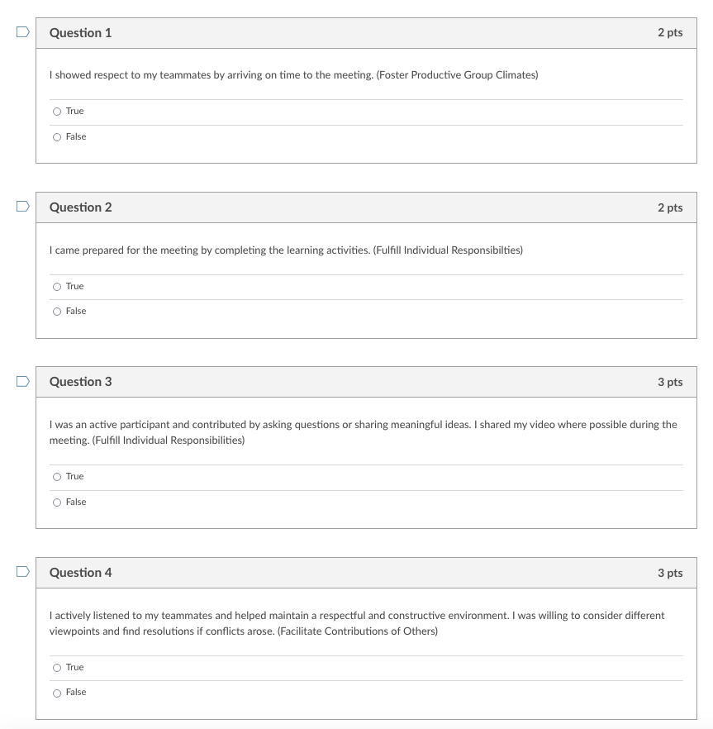
W03 Team Activity: Participation Report
https://www.byui.edu/byu-idaho-learning-outcomes#sc
Purpose: Being able to collaborate with others is an essential skill in any organization. The purpose here is for you to report on your teamwork and collaboration efforts.
This is an important part of the BYU-Idaho Learning Outcome: Skilled Collaborators..Links to an external site.
Task: Report your contributions to your team activity this week by answering the following questions.

